Slide 1

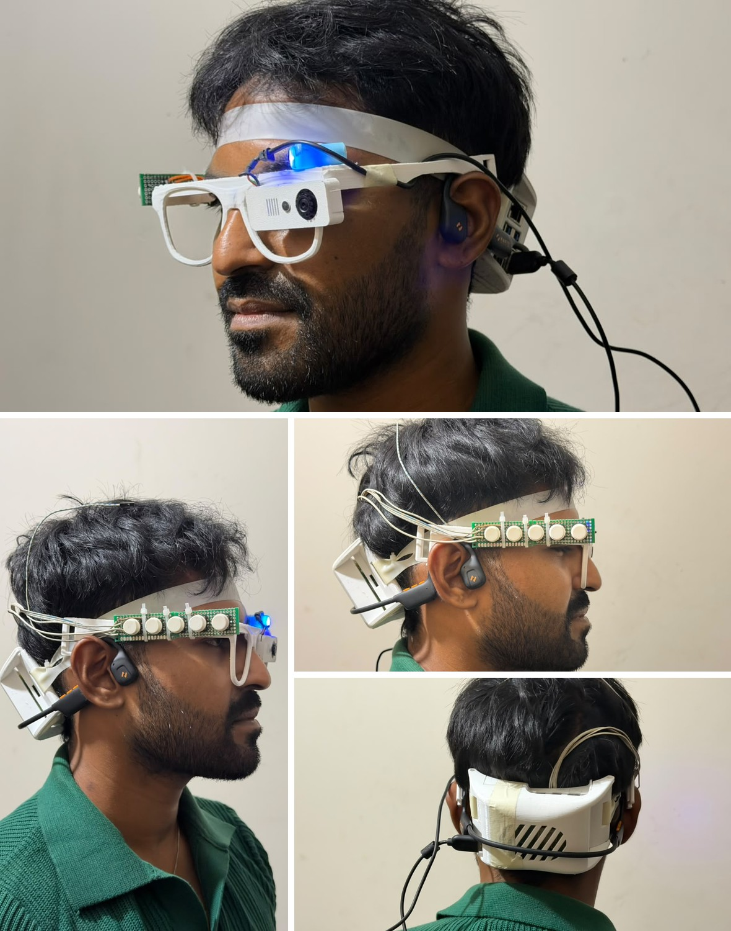
SARA · Smart Assistive Reading Aid
A Wearable Assistive Glass for Authenticating Bangladeshi Banknotes: Fusing Physical Security Features and Deep Learning for Visually Impaired Users
A bilingual (Bangla and English) smart glass that also reads printed Bangla and English text and detects everyday objects, offline on a Raspberry Pi 5
Supervisor:
Mohammad Shidujaman, PhD
Assistant Professor
Department of Computer Science & Engineering
Submitted By:
MD Abdun Fattah Lam (2220014)
Mukut Protim Memo (2020086)
Tanjila Hossain Tapti (2130561)
Notes:
We present SARA, a smart glass for blind and low-vision people in Bangladesh. It reads Bangla and English text, names objects, recognises Taka notes and checks them carefully, and it works on the device without the internet. The photo is the current prototype.

Slide 2
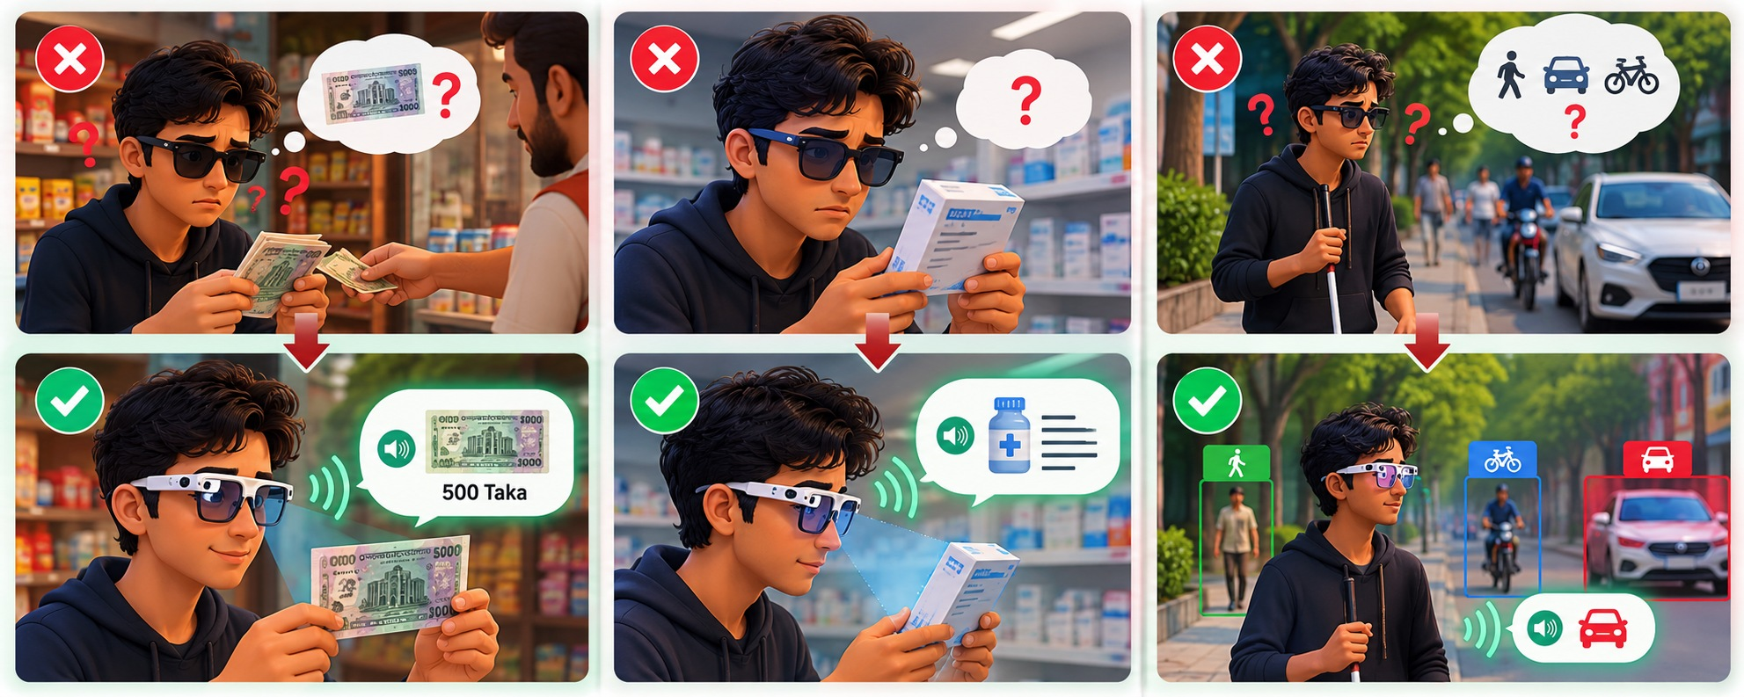
Introduction
At least 2.2 billion people have a near or distance vision impairment, and its prevalence in low- and middle-income regions is about four times that in high-income regions [1]
In Bangladesh, three everyday questions usually require help from another person:
  Money: which note was handed back, and is it genuine?
  Reading: what does a medicine label, sign or letter say?
  Surroundings: what or who is ahead?
In each case the blind person depends on an answer they cannot verify
SARA is an offline, bilingual assistive glass built for this setting
Money
Reading
Surroundings
Top row: today, an answer from another person. Bottom row: with SARA, the glass answers. (Illustration)
Notes:
At least 2.2 billion people have a vision impairment, and it is about four times as common in low- and middle-income regions. In Bangladesh, three everyday questions usually need another person: which note was handed back and whether it is genuine, what a medicine label, sign or letter says, and what or who is ahead. In each case the blind person depends on an answer they cannot check. SARA is an offline, bilingual glass built for exactly this setting.

Slide 3
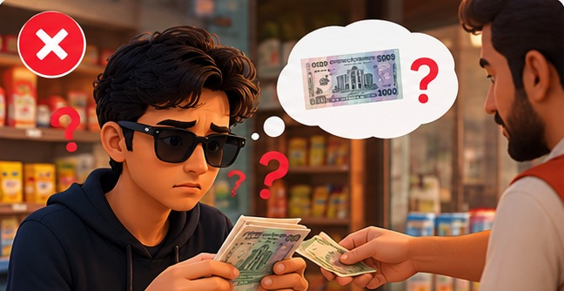


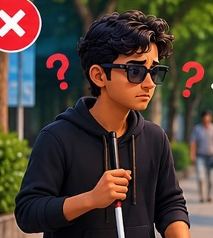
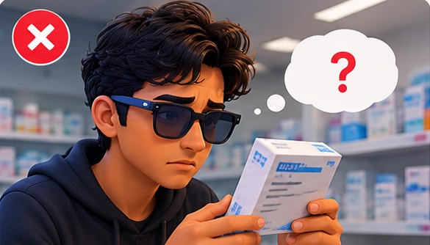

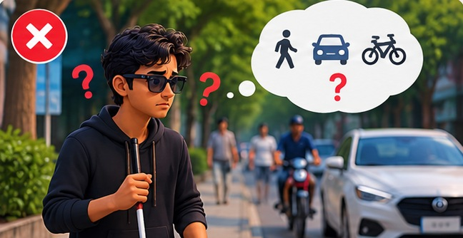

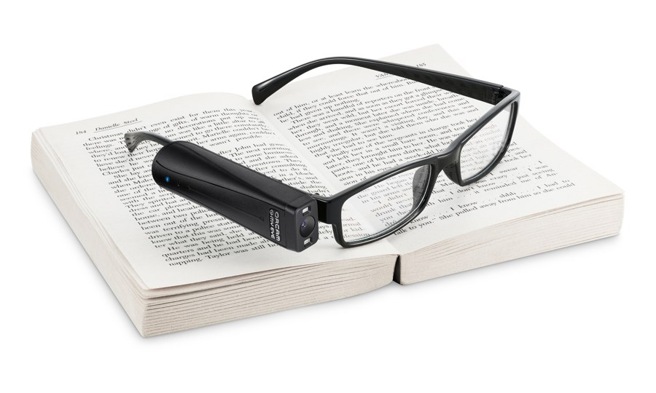
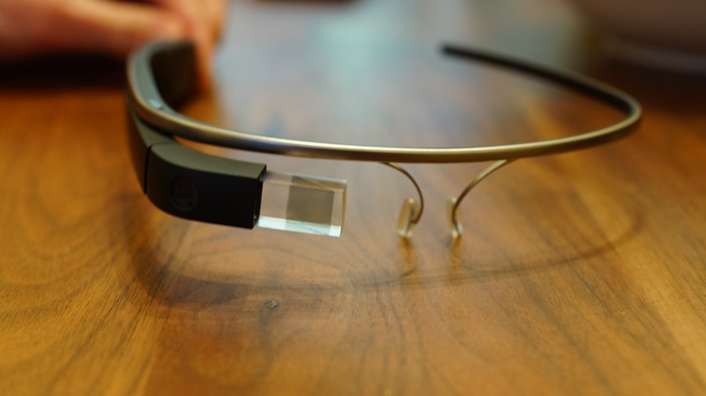
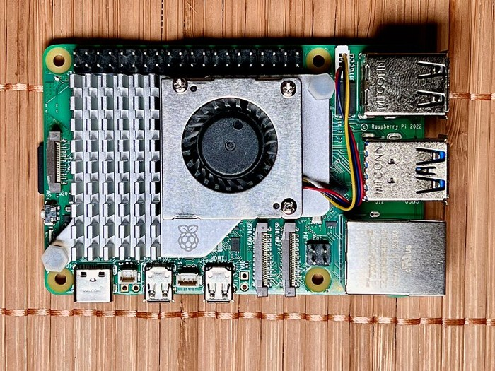
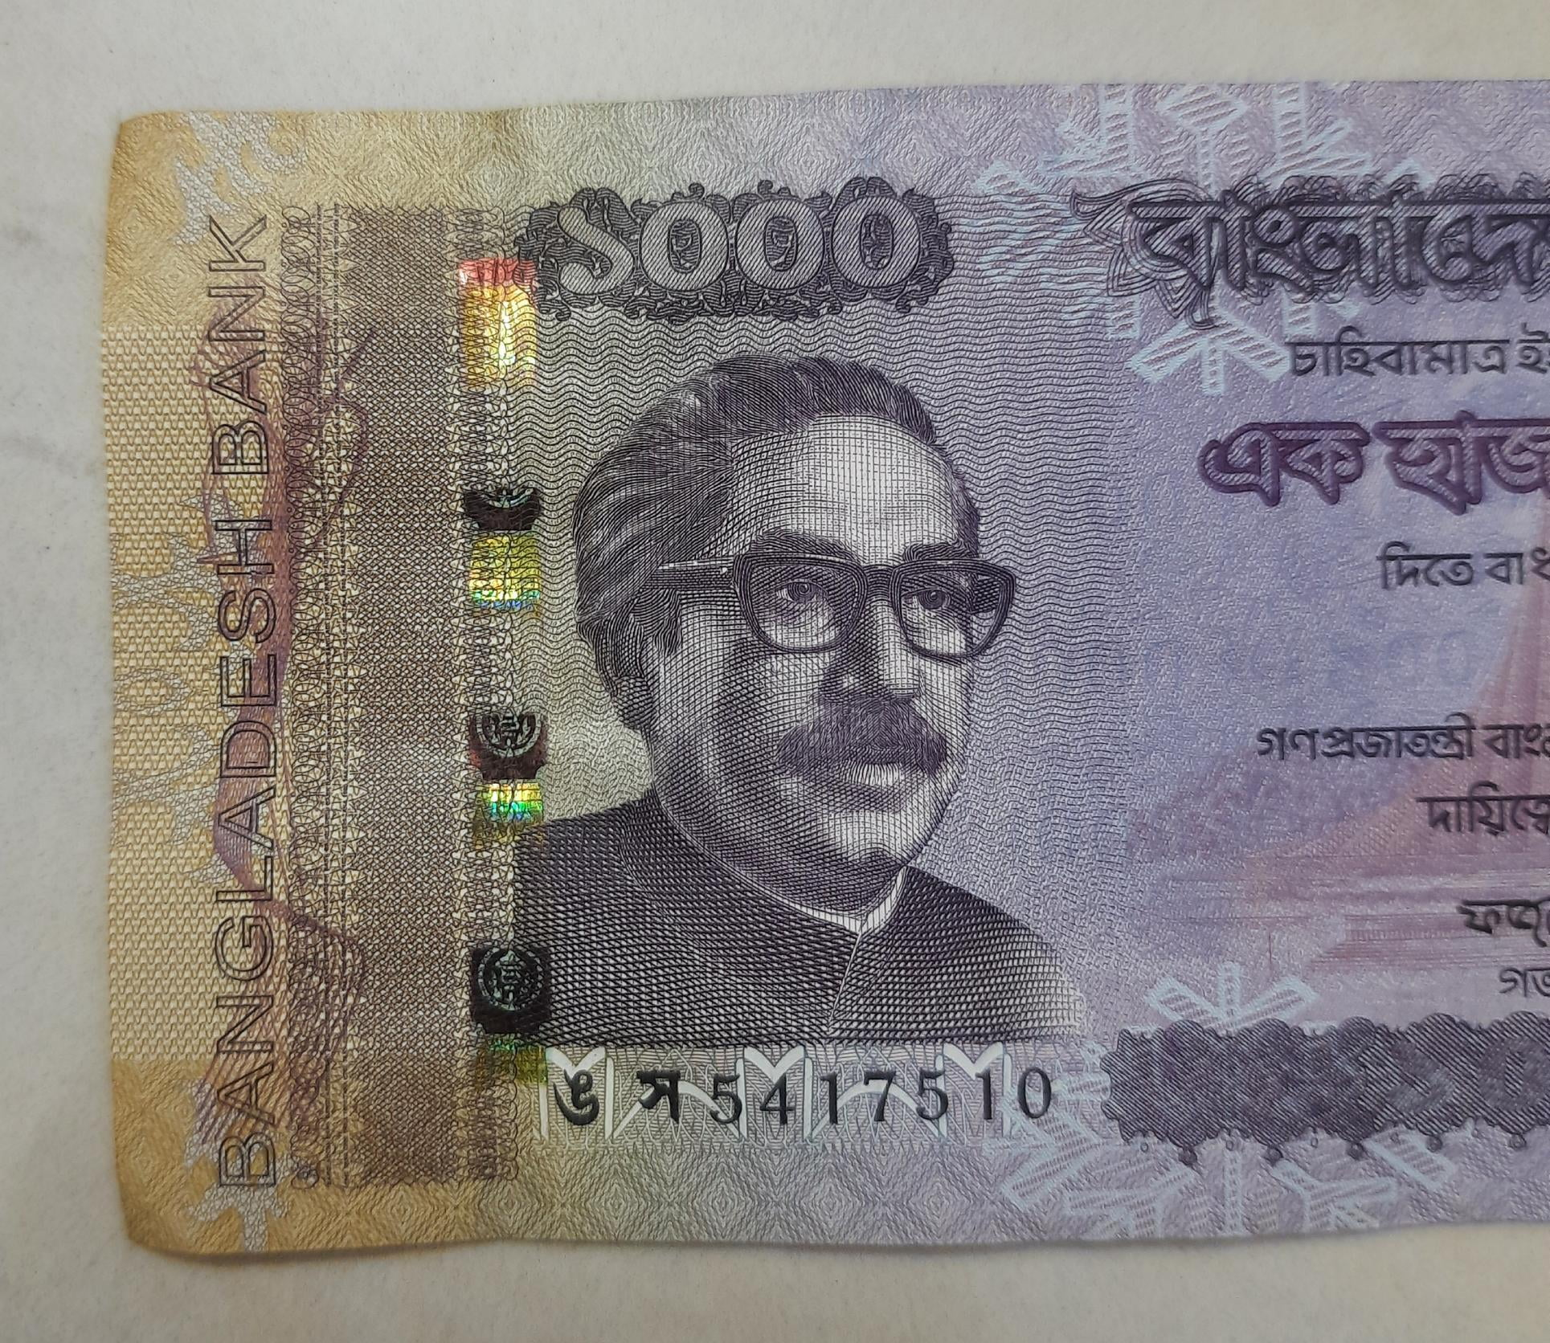
Problem Statement
Money: at the shop
Shopkeeper
gives an answer
receives change
must trust
Visually impaired user
An answer they cannot verify
A wrong note or a fake note can go unnoticed
A label or letter can be misread
Every task waits for someone else
needs a label read
Reading: at the pharmacy
Family or pharmacist
asks
Surroundings: on the street
A stranger
walks outside
asks the way
Existing aids do not close this gap
OrCam MyEye [2]
Research glasses [3, 4]
Pi reading aids [5]
Counterfeit studies [6, 7, 8, 9, 10]
The gap
No reviewed device is offline, speaks Bangla and names Taka notes
Offline, but no Bangla and no Taka
Pictures go to a server
Mostly English-only
Not on a wearable
Illustration
Notes:
This picture shows the problem. A visually impaired user receives change at a shop, needs a medicine label read at the pharmacy, or walks outside. Each time the answer comes from another person: the shopkeeper they must trust, a family member or pharmacist, or a stranger. So they end up with an answer they cannot verify: a wrong or fake note can go unnoticed, a label can be misread, and every task waits for someone else. Existing aids do not close this gap. OrCam MyEye works offline but does not list Bangla and does not name Taka notes. The research glasses send pictures to a server. Low-cost Raspberry Pi reading aids are mostly English-only. Studies on Bangladeshi counterfeit notes, and the JaalTaka benchmark, have not been brought to a wearable. No reviewed device is offline, speaks Bangla and names Taka notes.

Slide 4
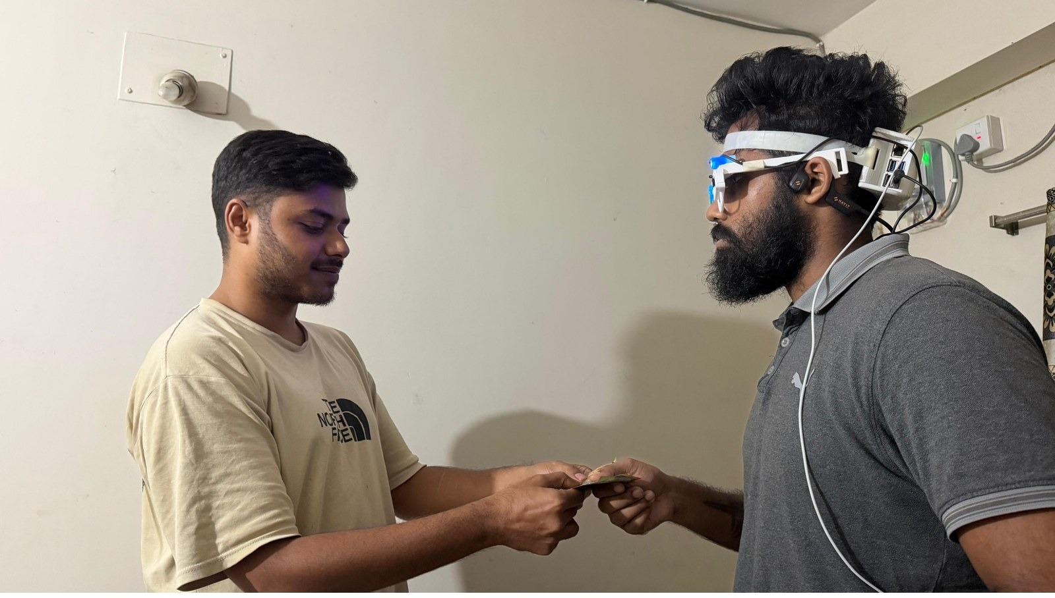
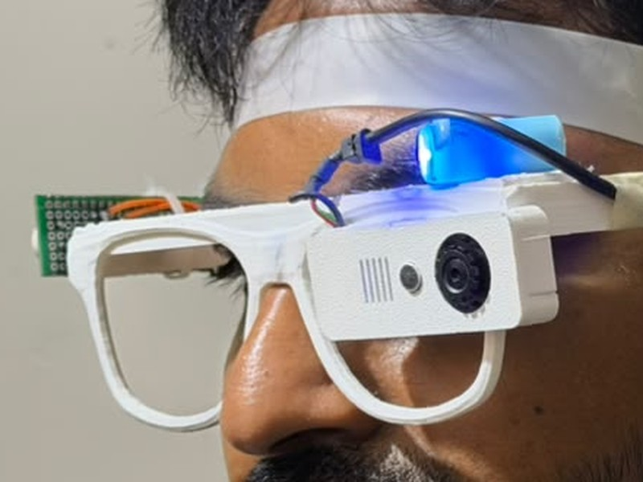
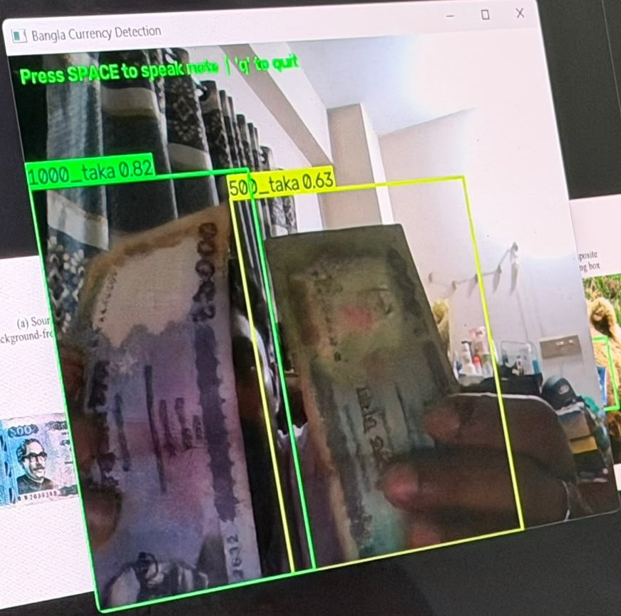
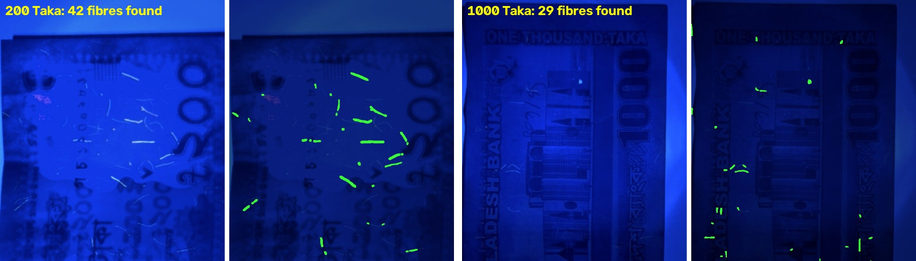
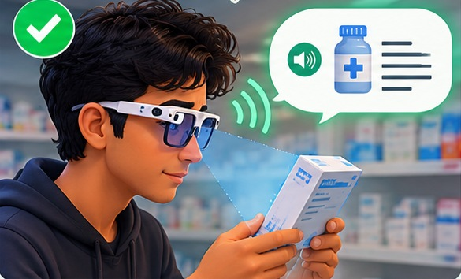
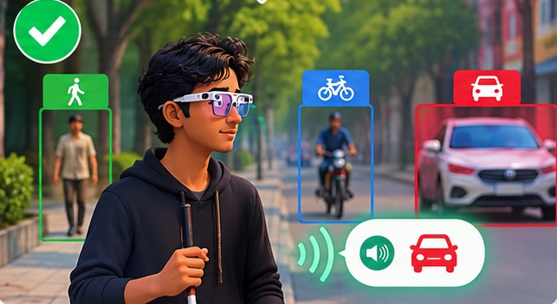
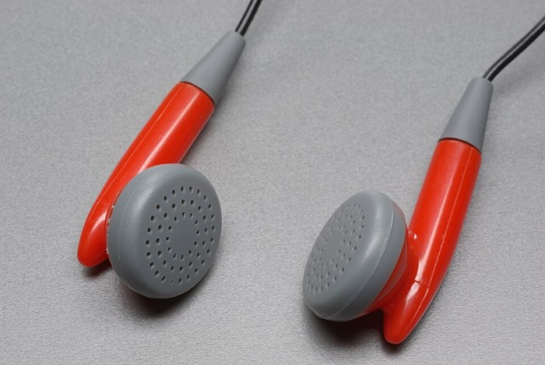
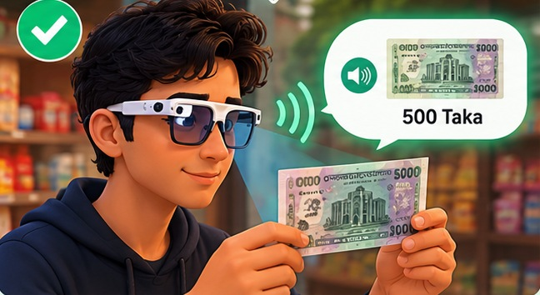

Proposed Solution: SARA
User wearing SARA (staged)
button, or "Glass, check money" [11]
Glass camera
captures a picture
Raspberry Pi 5 [12]
Offline: text, objects, Taka, emotion
Online (optional): scene description only
processes offline
Taka recognition [13]
Authenticity: watermark + UV
Text reading [14, 15]
Objects and people [13, 16]
Safe verdict (money)
Spoken answer in Bangla or English [17] + a short vibration
"Likely genuine" or "check by hand whether it is genuine"; it never says "counterfeit"
পাঁচশত টাকার নোট
"500 Taka note": known without asking anyone
Notes:
This picture is the same moment with SARA. The user presses a button or says glass, check money. The glass camera captures a picture, and the Raspberry Pi 5 processes it on the device without the internet. Depending on the mode, it recognises the Taka note, checks the watermark and the UV security fibres, reads Bangla or English text, or names objects and people ahead. For money, the safe verdict says likely genuine or check by hand, and never says counterfeit. The answer is spoken in Bangla or English through the bone-conduction headphone with a short vibration, for example five hundred Taka note, so the user knows without asking anyone.

Slide 5
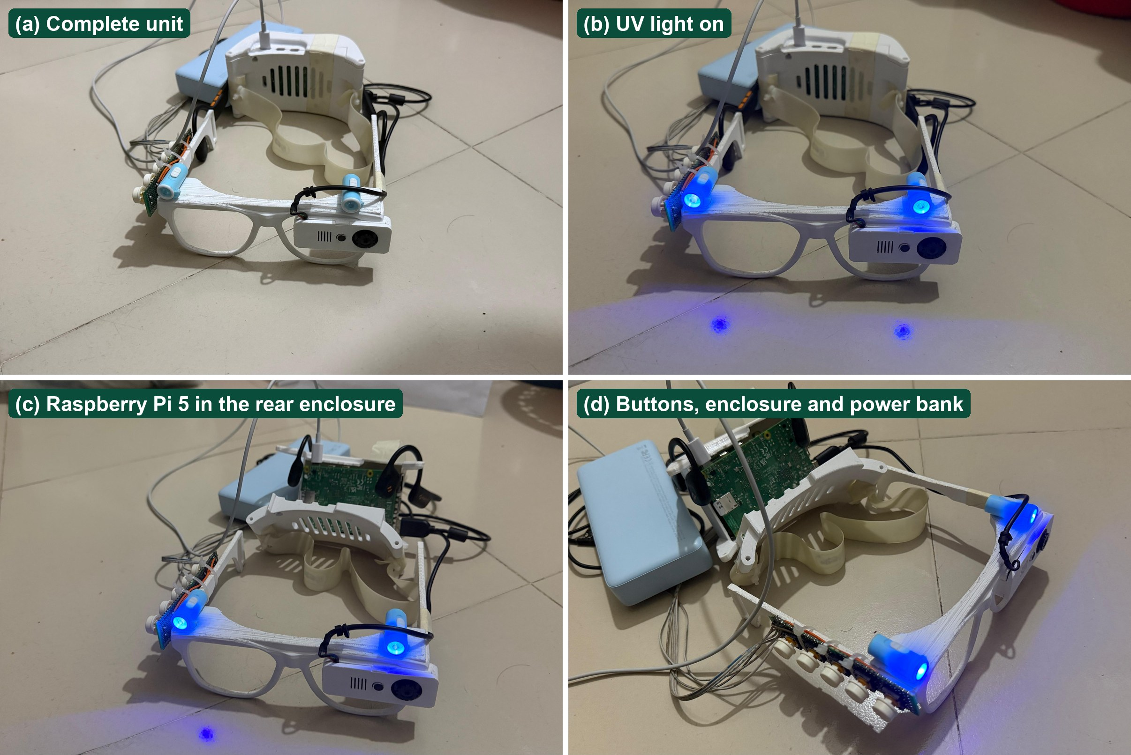







System Features
Text reading
Objects
Taka notes
Bangla and English
Named in Bangla
Value + safe check
Emotion
Online description
Face in front
Optional; needs internet
Prototype version 2: the complete unit, the UV light on, the Pi 5 in the rear enclosure, buttons and power bank
How the user starts a mode: five buttons on the frame, or a voice command: "Glass, read text"
Models: text [14, 15] CRAFT + EasyOCR; objects [13, 16] YOLOv8 on COCO; emotion [18] RAF-DB; voice commands [11] Vosk.
Notes:
This is the current prototype: the camera and five buttons sit on the frame, a bone-conduction earphone leaves the ears free, and the Raspberry Pi 5 rides in a ventilated enclosure at the back of the head. Five modes cover text, objects, Taka notes, emotion and an optional online description. Every mode can be started with a button or with a voice command that begins with the word glass.

Slide 6
Research Questions
1
System
2
Synthetic data
3
Number of views
Can it all run on a Raspberry Pi 5?
Can unlabelled training data detect real notes?
Can one view of a note be enough?
4
Unseen prints
5
Safety
6
Bangla OCR
Does the check hold on new counterfeit prints?
Can it never accuse a genuine note?
What matters most for reading Bangla?
Notes:
Six questions organise the talk. First, whether a multi-function Bangla glass runs on a Raspberry Pi 5 and how fast. Second, whether a Taka detector trained without hand labels works on real, hand-held photos. Third, why multi-view counterfeit models fail with fewer views and whether training fixes it. Fourth, how much accuracy drops on counterfeit prints never seen in training. Fifth, whether the glass can give counterfeit advice that never accuses a genuine note. Sixth, which part of a Bangla OCR pipeline matters most for a wearable camera.

Slide 7
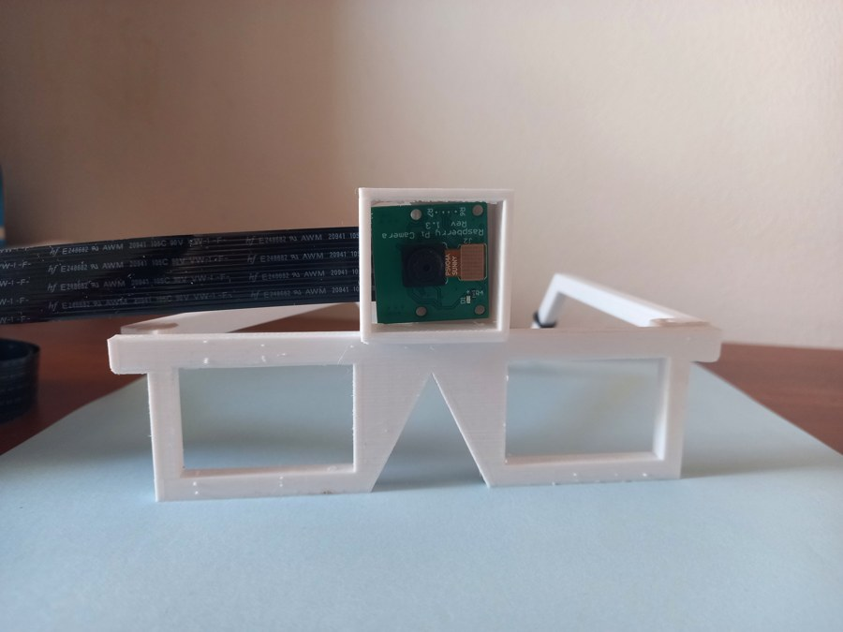
Literature Review: Existing Assistive Devices
System | Reads Bangla | Knows Taka | Works offline | Wearable
OrCam MyEye [2] | No | No | Yes | Yes
Google Glass scene analysis [3] | No | No | No | Yes
AIris (2024) [4] | No | No | No | Yes
Raspberry Pi reading aids * | No | No | Partly | Partly
SARA (ours) | Yes | Yes | Yes | Yes
The research gap
None of the systems we reviewed combines Bangla, Taka and offline use.
Counterfeit tests reuse the same prints
Few report speed on the real device
Rows with a reference: from the cited source. * Our assessment of typical hobby builds, not a cited result.
OrCam MyEye [2]
Google Glass analysis [3]
AIris [4]
Photos: OrCam MyEye by Ylip, CC BY-SA 4.0; Google Glass by Ted Eytan, CC BY-SA 2.0 (Wikimedia Commons); AIris from [4]. Comparison from [2, 3, 4].
Notes:
Commercial glasses such as OrCam work offline but not in Bangla and not with Taka. Glass-based research systems send pictures to a server. Raspberry Pi reading aids are cheap but mostly English. No device combines Bangla, Taka and offline use, and counterfeit studies do not check for copies of the same print in training and test.

Slide 8
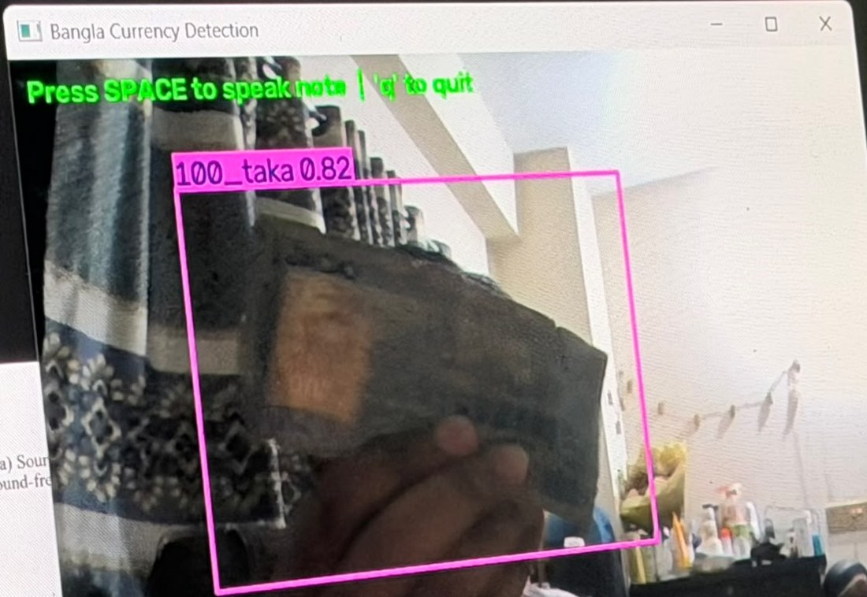
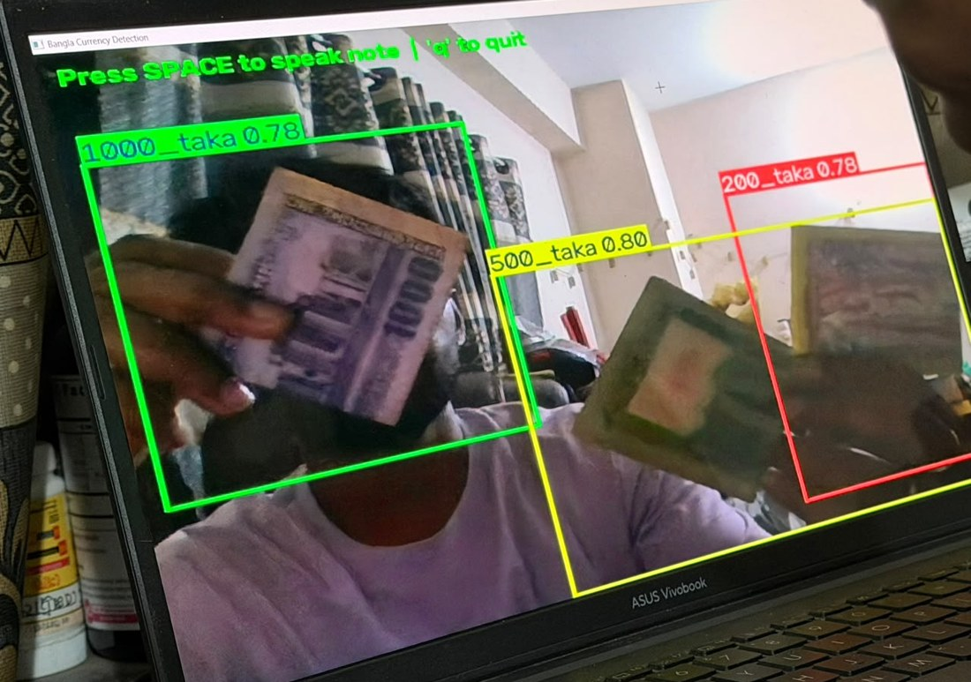
System Architecture
Input
camera frame, 640×480
Mode manager: starts one stream
Text-reading stream
Spoken Output
Resize
CRAFT
Text block
EasyOCR
Answer sentence: Bangla or English
Speech: Piper [17], eSpeak NG [19]
পাঁচশত টাকার নোট
[canvas 2560]
text detector [14]
main block + clean-up
fine-tuned, blended [15]
Taka stream
"Likely genuine" or "check by hand"
Resize
YOLOv8s
Watermark
UV check
Bangla or English text read aloud
[640]
Taka detector [13]
4 windows + DMWR
security fibres
Object stream
Objects ahead named
Trigger
5 buttons, or voice: "glass, …" [11]
Resize
YOLOv8s
Announce
[640]
Facial expression
COCO objects [13, 16]
names new objects
Emotion stream
Face
EfficientNet-V2-S
Expression
Vibration for a note
[YuNet detector]
RAF-DB [18]
facial expression
All streams run on the Raspberry Pi 5 CPU, offline. The optional online scene-description mode is not shown.
Sources: [11] Vosk; [13] Ultralytics YOLOv8; [14] Baek et al. 2019; [15] EasyOCR; [16] COCO; [17] Piper; [18] RAF-DB; [19] eSpeak NG.
Notes:
The architecture, drawn as streams. A camera frame of 640 by 480 comes in on the left, and a button press or a voice command starting with glass tells the mode manager which stream to start. The text-reading stream runs the CRAFT detector at a canvas size of 2560, keeps the main text block, and reads it with our fine-tuned EasyOCR recogniser. The Taka stream finds the note with YOLOv8s at 640, then checks four watermark windows with DMWR and counts the UV security fibres. The object stream runs YOLOv8s trained on COCO and names new objects. The emotion stream finds a face with YuNet and classifies the expression with EfficientNet-V2-S trained on RAF-DB. Whatever stream ran, its result becomes one Bangla or English sentence, which Piper speaks, with eSpeak NG as a fallback, and a short vibration confirms a note.

Slide 9
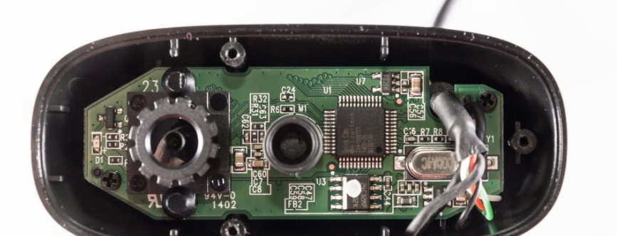
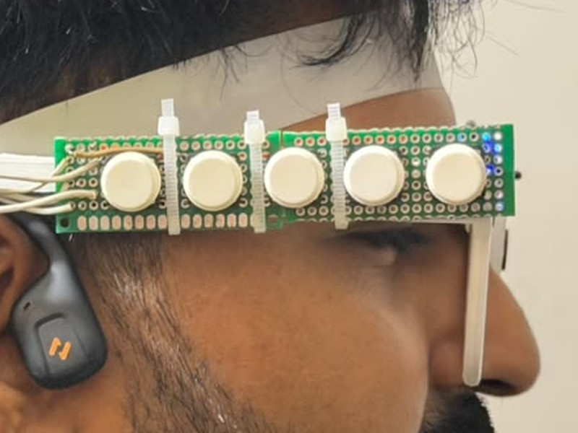
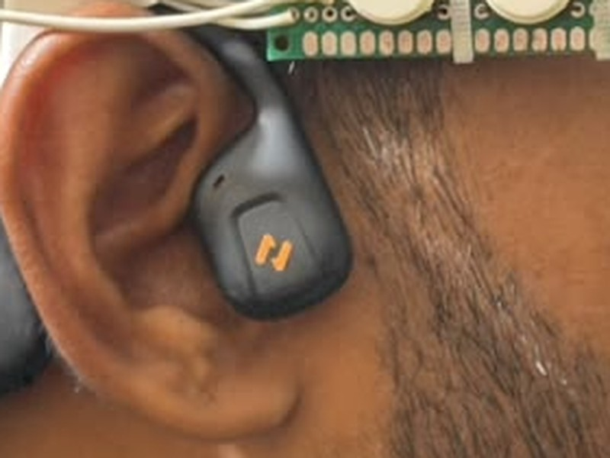
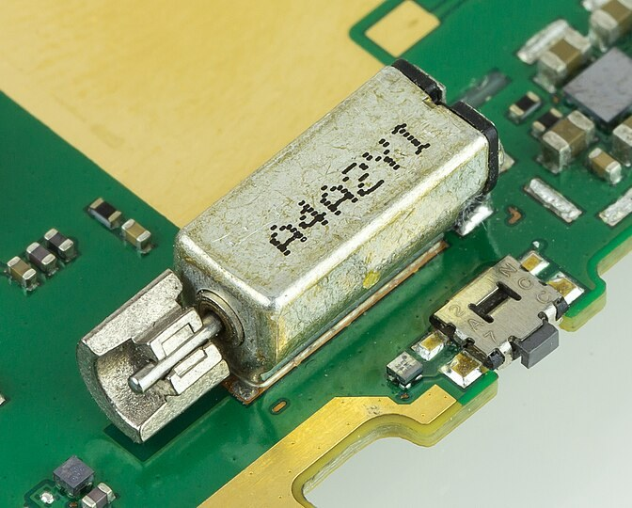
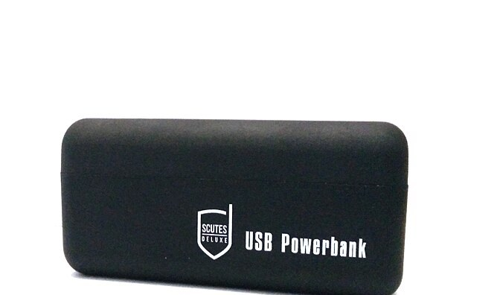
Hardware Design
MODE · BCM 17
ACTION · BCM 27
USB cable
READ · BCM 24
VOL+ · BCM 22
VOL− · BCM 23
USB webcam (our board)
GND
Five push-buttons
audio out
BCM 13 (PWM)
Bone-conduction headphone
Vibration motor
USB microphone (optional)
USB-C, 5 V
Lamp 360–395 nm, switched by hand; not wired to the Pi
Raspberry Pi 5, 8 GB [12], in the rear enclosure
Power bank
5 V power
USB
GPIO input, to GND with pull-up
ground
Frame + UV-A lamp
Schematic, not to scale; pin numbers are those set in the code.
Pictures (Wikimedia Commons): Raspberry Pi 5 by SimonWaldherr, CC BY 4.0; vibration motor by Raimond Spekking, CC BY-SA 4.0; power bank by Pinguinguy, CC0. Webcam board, buttons, headphone and frame: our prototype.
Notes:
This is how the second prototype is wired. The Raspberry Pi 5 sits in the rear enclosure and runs every model. The camera is a USB webcam plugged into a USB port of the Pi. The five push-buttons each connect one GPIO pin to ground, BCM 17 for MODE, 27 for ACTION, 24 for READ, 22 for volume up and 23 for volume down, with internal pull-up resistors. The vibration motor is driven by PWM from BCM 13. Speech goes to the audio output and the bone-conduction headphone, and a USB microphone can be plugged in for voice commands. A power bank supplies 5 volts through the USB-C port. The UV lamp on the frame is switched by hand and is not wired to the Pi.

Slide 10
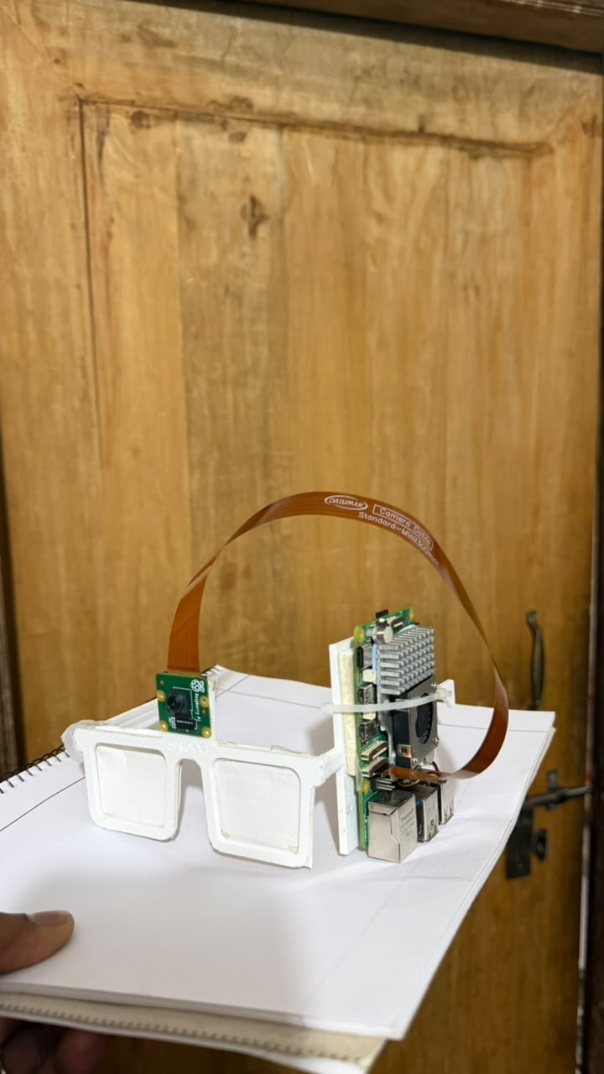
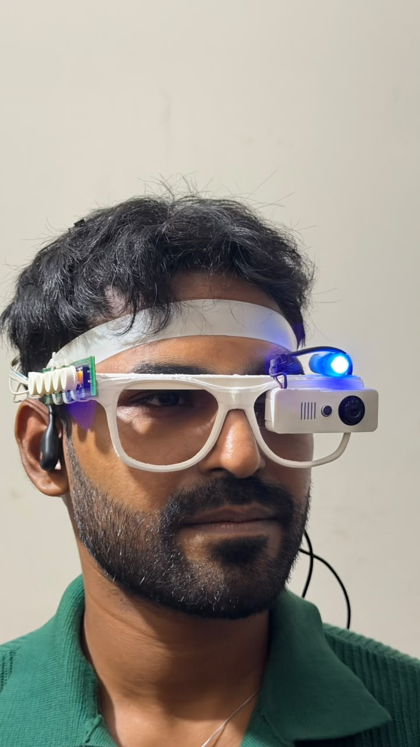
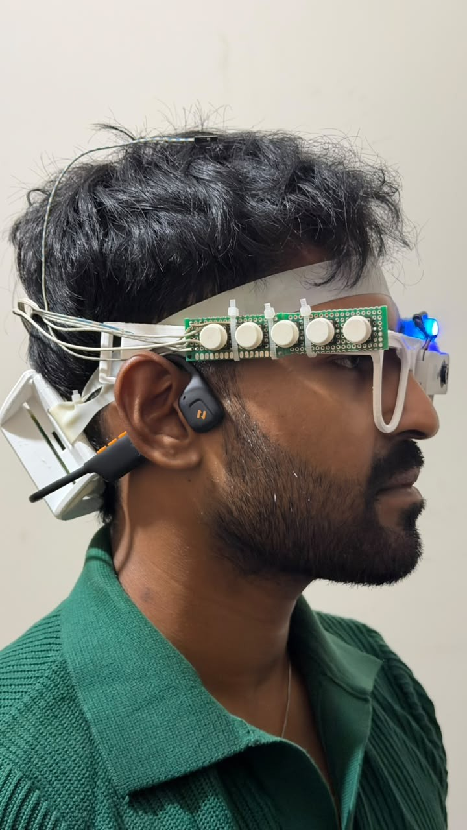
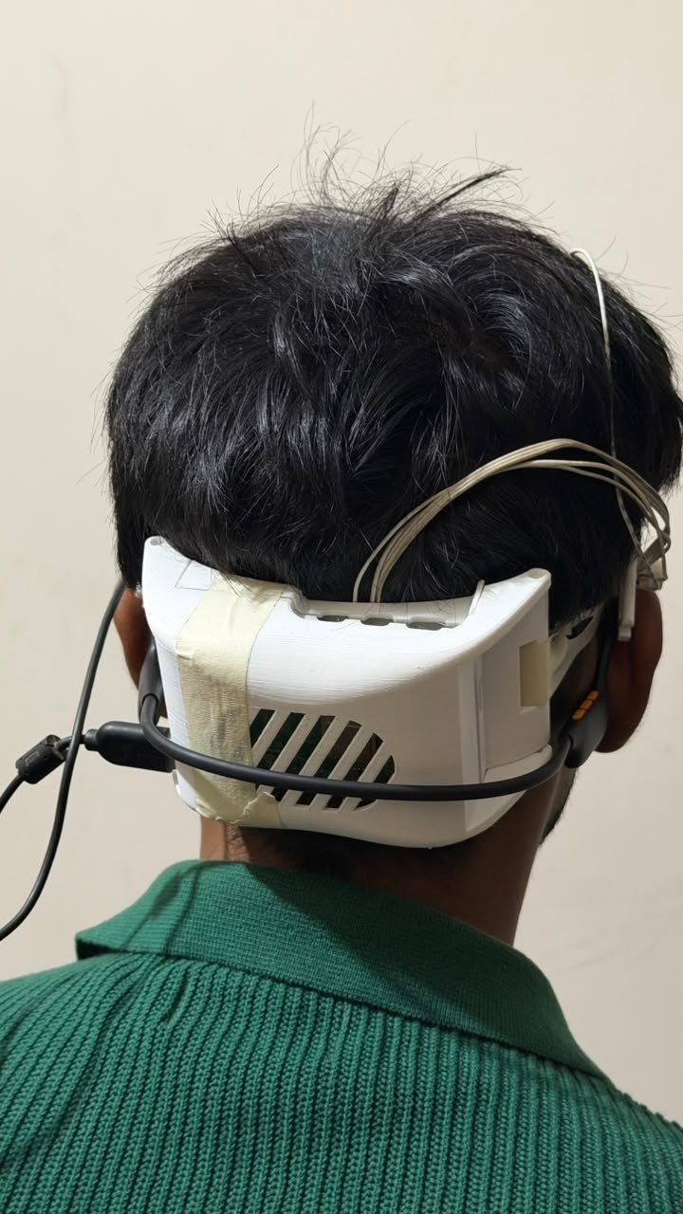
Evolution of the Prototype
Version 2
Version 1
Board on one temple
Front
Camera + UV lamp
Side
5 buttons, bone-conduction earphone
Rear
Pi 5 in a ventilated case
Notes:
The first version put the board and fan on one temple: heavy on one side and loud by the ear. Version two moves the Raspberry Pi into a ventilated enclosure at the back of the head, keeps the camera and a small UV lamp on the front, puts five buttons along the frame and uses a bone-conduction earphone so the ears stay free for traffic sounds.

Slide 11
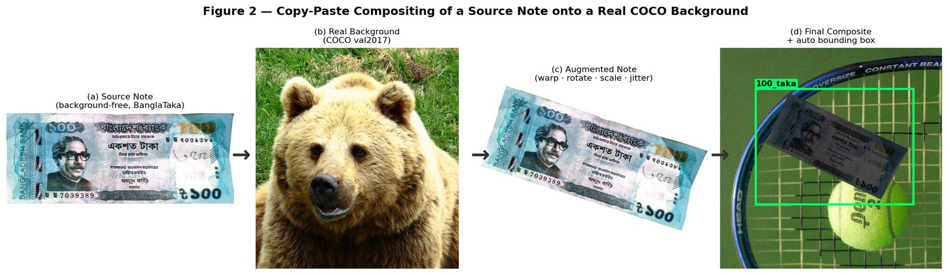
Banknote Detection: Synthetic Training Data
SYNTHETIC COMPOSITES
0.995
mAP@0.5 on 2,282 held-out composites
Note photos [20] are pasted onto real scenes [16], and the program writes every label itself.
REAL PHOTOS
94.1%
right note value on 1,536 photos taken by other people (laptop)
Sources: [20] BanglaTaka (Mendeley); [16] Lin et al., COCO, ECCV 2014; detector [13] Ultralytics YOLOv8. 94.1% with the hand-held detector (next slide).
Notes:
Public Taka images are clean close-ups, so a model trained on them fails on a live camera. We pasted 5,073 note photos onto real COCO pictures with random angle, scale, light and blur, and let the program write the box labels. The detector scores 0.995 mAP on held-out composites and, the number that matters for users, names 94.1 percent of 1,536 real photographs taken by other people correctly. The two numbers measure different things: the first is on synthetic composites, the second on real photos.

Slide 12
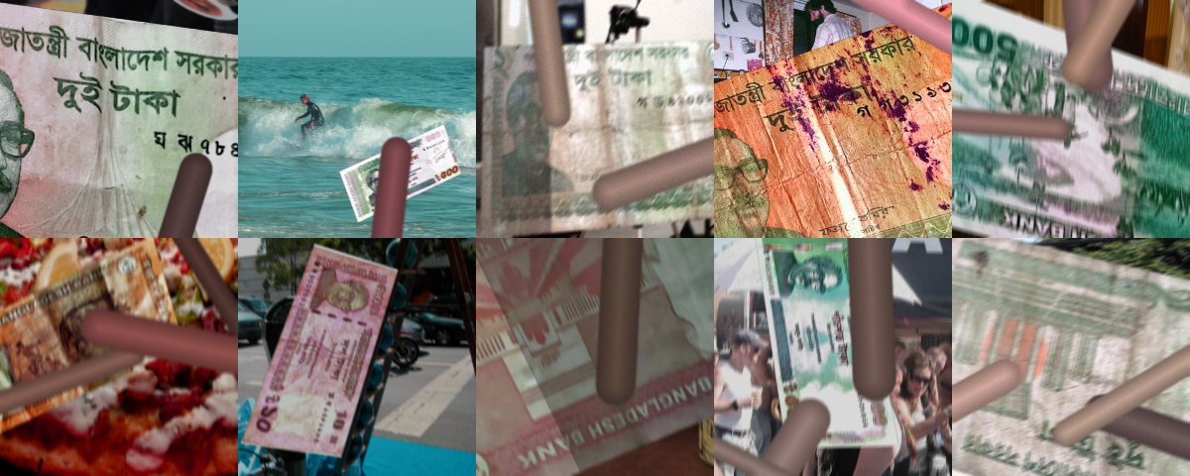
Banknote Detection: Hand-Held Notes
TRAINING: 6,000 SYNTHETIC CLOSE-UPS
TEST: REAL HAND-HELD PHOTOS
11.8% → 47.5%
Right note value on the laptop. Trade-off: with 3 notes in view, the total is right 97.0% (was 99.2%).
Sources: test photos [21] Rafi et al., NSTU-BDTAKA, Data in Brief 2024; detector [13] YOLOv8. Our results: paper_evidence/HANDHELD_FINETUNE.md.
Notes:
A blind user holds the note close, folded and under the fingers, and our training pictures showed whole notes in scenes. We generated six thousand hand-held close-ups from training notes only and fine-tuned the detector. On the independent NSTU hand-held test, the right value rises from 11.8 to 47.5 percent on the laptop and from 8.7 to 33.5 percent on the Pi. There are costs: one-taka notes are named more often by mistake (36.6 percent), and with three notes in view the total is right 97.0 percent of the time instead of 99.2.

Slide 13
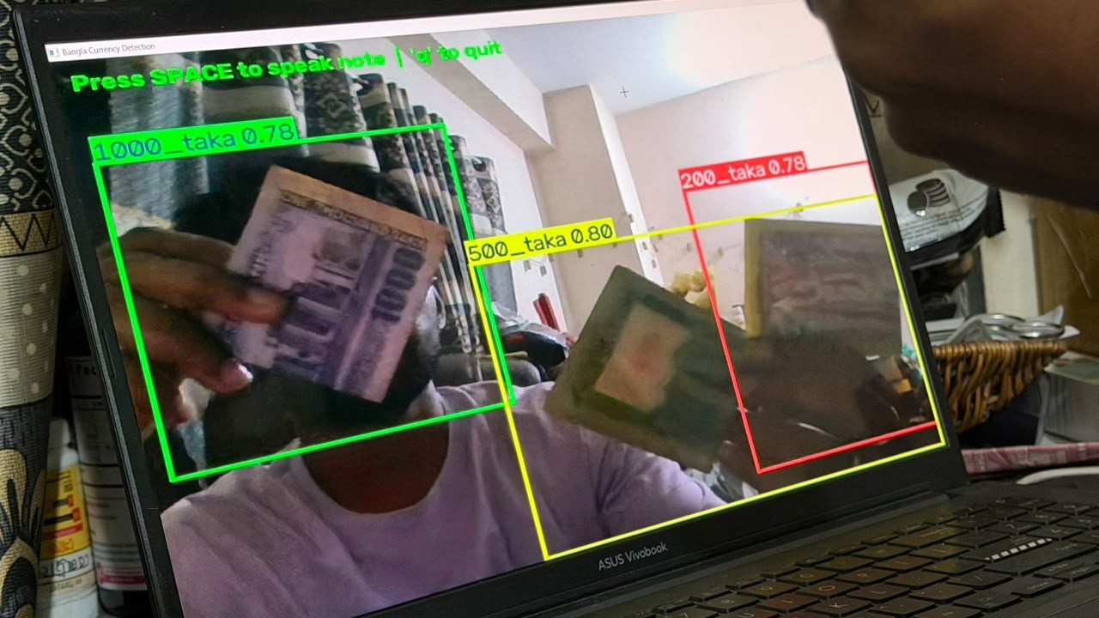
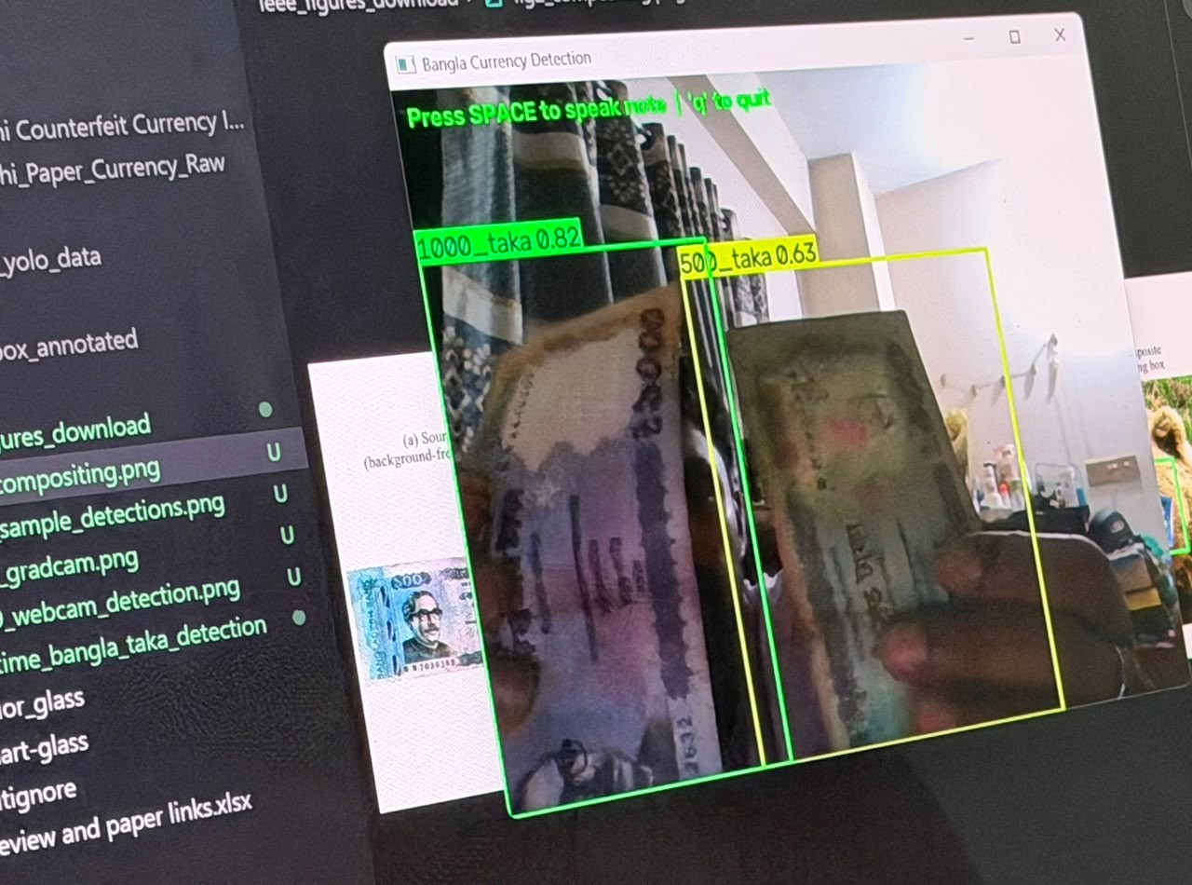
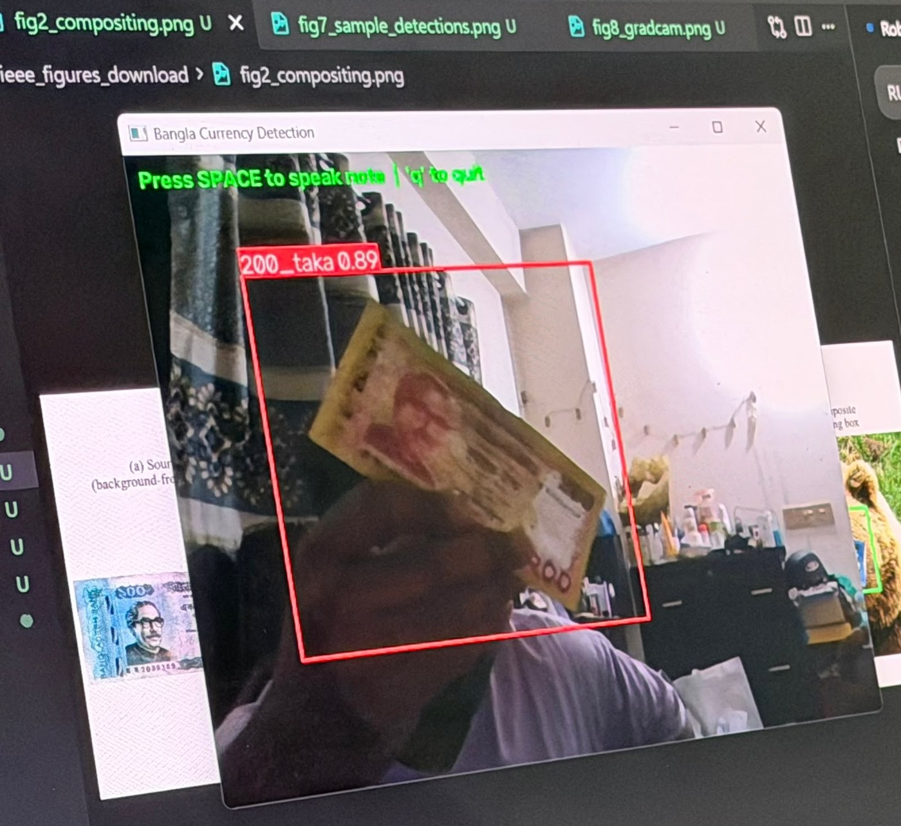
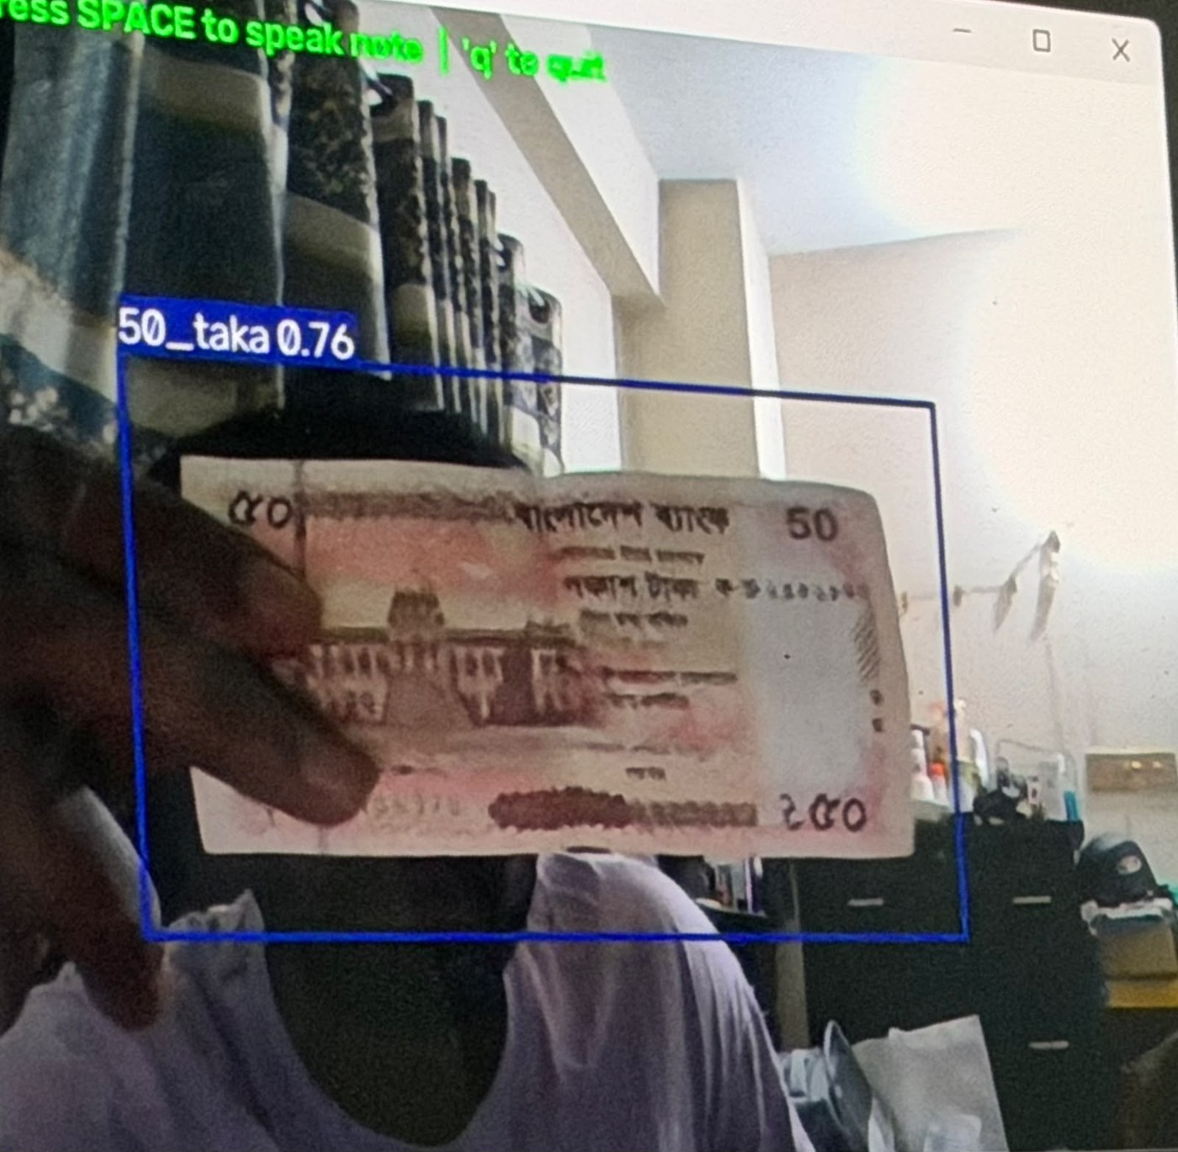
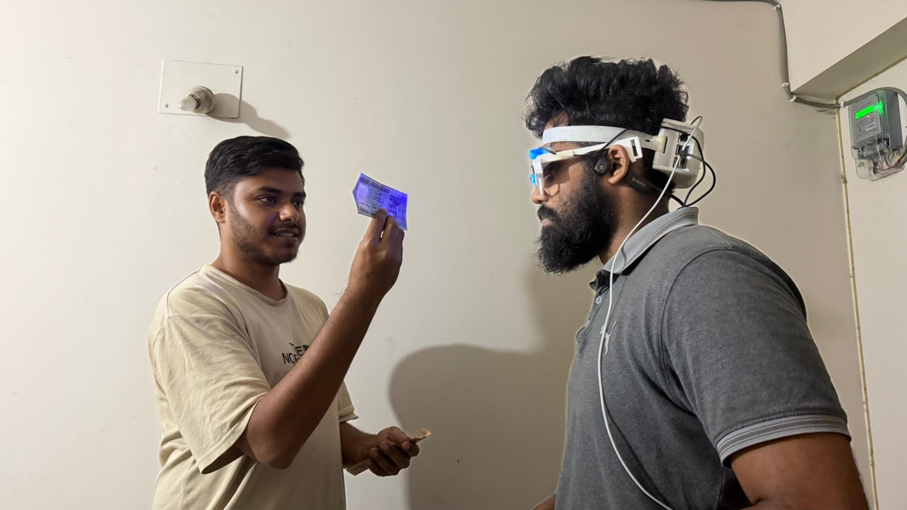
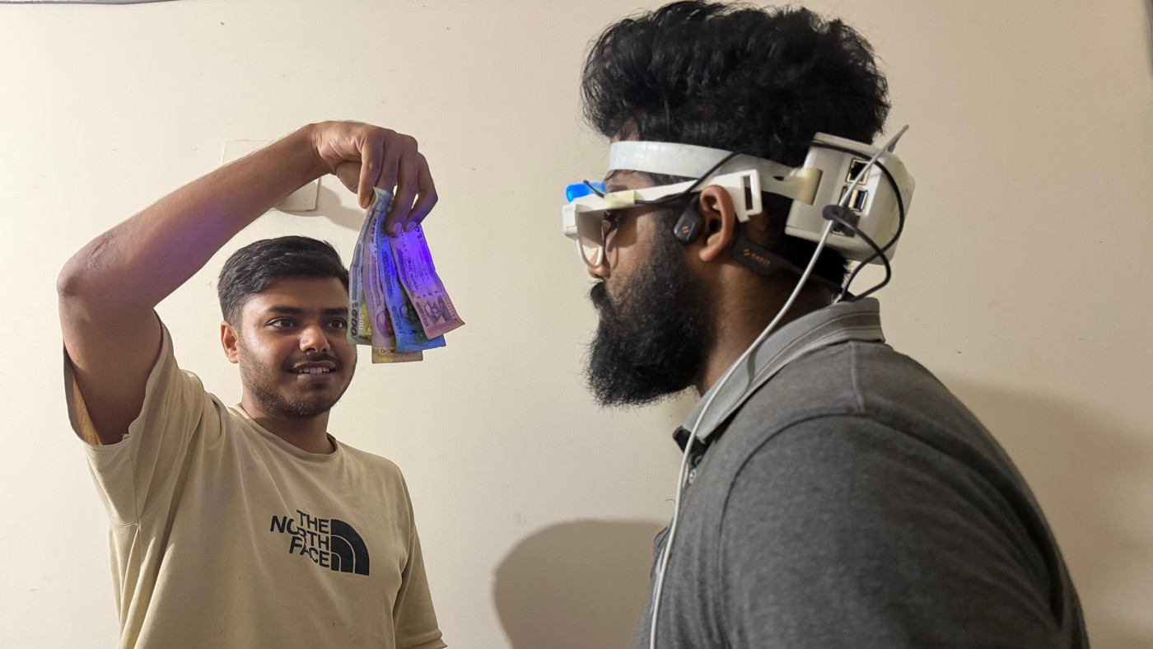
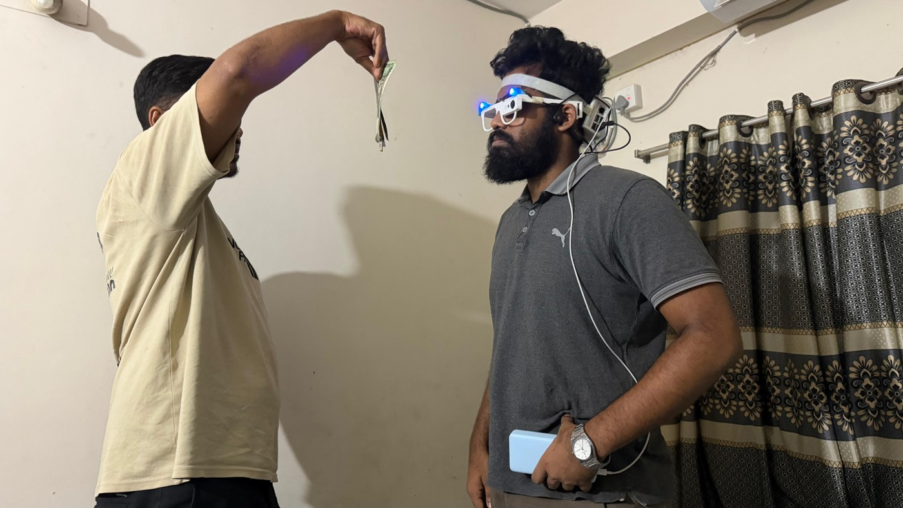
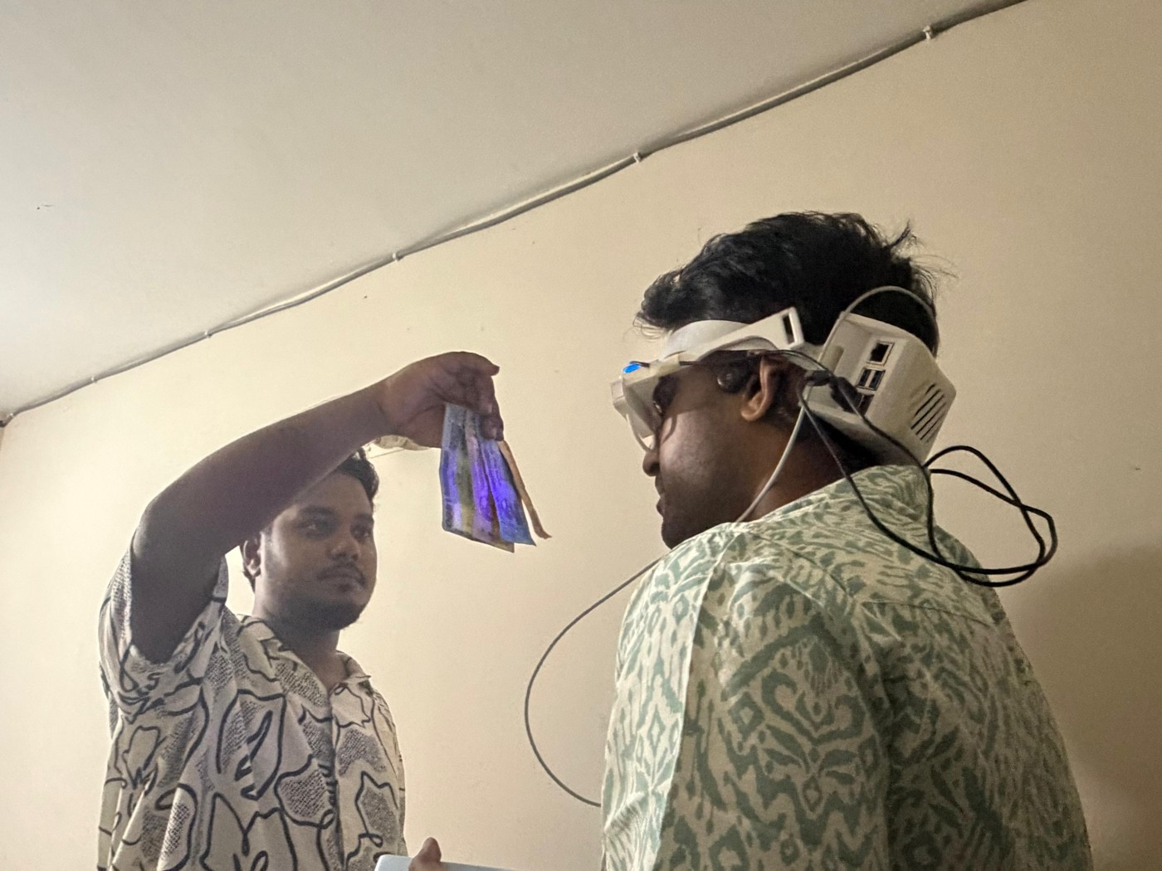
Live Detection Tests
Informal demonstrations, not a measured accuracy study
Software: live detection on a laptop webcam (detector output shown)
Second prototype (v2): live tests with the glass (staged)
Screenshots: 50, 200, 500 and 1,000 Taka named at 0.63–0.89 confidence, two or three notes at once. The v2 photos do not show the detector output.
Notes:
The top row is the software on a laptop webcam: the detector draws a box with the note value and its confidence. Fifty, two hundred, five hundred and one thousand Taka were named at 0.63 to 0.89 confidence, with two or three notes at once. The bottom row is the second prototype in live tests: a team member holds a note up in front of the glass camera; these scenes are staged and the photos do not show the detector output. We did not count an error rate in these sessions.

Slide 14
Counterfeit Screening: Prefix-Robust Multi-View Training
With a single view
71.2%
rises to
98.2%
Training on random first views: one view is enough.
Held-out JaalTaka test notes, never used for training or for any choice
Data: [9, 10] Piyas et al., JaalTaka dataset and article, 2025-2026 (1,390 notes, six views each; counterfeits seized by the Rapid Action Battalion).
Notes:
A blind user cannot promise to capture six views of a note. A model trained only with all six views collapses to 71 percent with one view. Training on random prefixes of the views, that is the first k views for a random k, keeps it at about 98 percent from one to six views, with no loss at six views and stable results across three seeds.

Slide 15
Counterfeit Screening: Evaluation on Unseen Prints
95.0%
on counterfeit prints never seen in training, with the watermark check
Why a stricter split: 279 of 322 readable 500 Taka counterfeits share one serial number, so the usual split tests copies of known prints.
Data: [9] JaalTaka; serial-number audit and print-disjoint split are ours. Earlier Taka counterfeit work: [6] SVM on security features; [7] CNNs; [8] UV flecks + RPN.
Notes:
Most counterfeit notes in JaalTaka are copies of a few prints, so the usual test measures recognition of known reprints; a serial-number lookup alone scores 90.2 percent. On truly unseen prints our network drops to about 89 percent; adding the watermark check brings it to 95 percent.

Slide 16
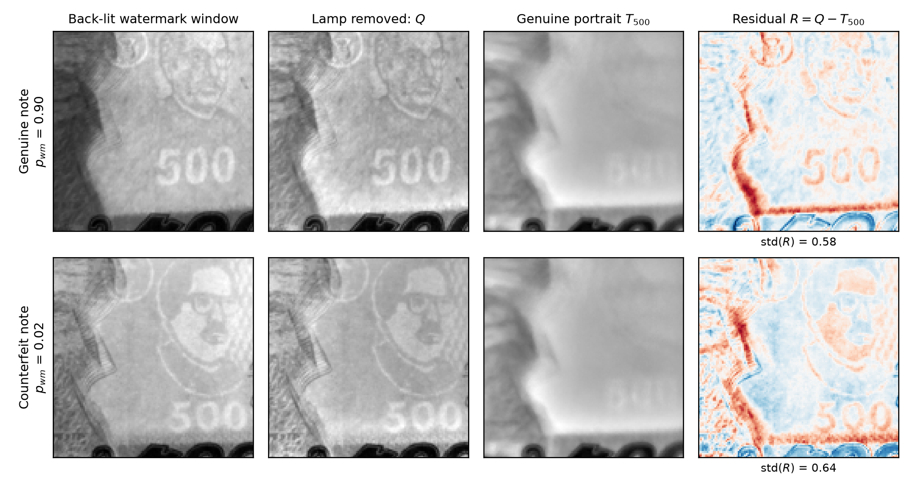
Watermark Verification: DMWR
91.5%
on unseen counterfeit prints (3 seeds, ±0.3)
46× smaller
than MobileNetV2 [22] (47,818 parameters, 0.21 MB), and as accurate: 92.9%, p ≥ 0.375
1. Remove the lamp: Q = I / (G∗I)
2. Genuine portrait: T = median of Q over genuine notes
3. Residual R = Q − T → two small CNN streams → "watermark clear?"
Baseline [22] Sandler et al., MobileNetV2, CVPR 2018; data [9] JaalTaka. DMWR (denomination-matched watermark residual) is our method.
Notes:
Our watermark method divides the back-lit photo by a blurred copy to remove the lamp, subtracts a genuine portrait of the note value and classifies the residual with two tiny networks. With under fifty thousand parameters it reaches 91.5 percent on unseen prints, statistically level with a MobileNetV2 46 times larger.

Slide 17
Safe Verdict Policy
"Likely genuine"
0 / 88
Score above the safe threshold?
yes
test counterfeits passed as "likely genuine"
Note captured
no
"Check by hand" + guided watermark check
"Likely genuine": the score is higher than every counterfeit seen in validation (57.5% of genuine notes).
"Check by hand": the glass is not sure. It never means "counterfeit".
A screening aid, not a guaranteed counterfeit detector
Test notes: [9] JaalTaka.
Notes:
Because a blind user cannot verify the answer, the glass never says a note is counterfeit. It says likely genuine only above a threshold set from validation counterfeits; otherwise it asks for a check by hand. The threshold is the highest score of any validation counterfeit, so a new counterfeit passes with probability about 1 in n plus 1, roughly 1.1 percent. No test counterfeit passed, and 57.5 percent of genuine notes are confirmed from close-up views.

Slide 18
UV Security-Fibre Verification
85.6%
88.6%
Prototype, off by default
The rejection result is simulated; it must be validated on real counterfeit notes
of 111 real UV photos of genuine notes accepted
of SIMULATED fibre-free sheets rejected (not real counterfeits)
The glass's lamp emits 360-395 nm, covering the 365 nm used for banknote checks; banknote paper stays dark while its fibres glow [23]. Prior Taka UV work: [8] (96.3%). Fibre check and photos are ours.
Notes:
Under a UV lamp, genuine 200, 500 and 1000 Taka notes show glowing security fibres. Our check removes the lamp's own blue light and counts thin glowing marks. It accepts 85.6 percent of real genuine photos and rejects 88.6 percent of simulated fibre-free sheets. It stays off by default until real counterfeits are tested.

Slide 19
Bangla and English Text Recognition
Rendered text (clean)
Real word photos (hard)
What helped
Reading the main text block only
Tuned detector and clean-up
Recogniser fine-tuned on real words
What did not
Binarisation, Tesseract, TrOCR, PaddleOCR, dictionaries
Character error rate, lower is better. Measured on evaluation datasets, not yet through the glass.
Engine [15] EasyOCR with [14] CRAFT; real words from [24] ICDAR 2019 MLT (1,000 test words). Every choice made on validation data.
Notes:
On our rendered Bangla and English benchmark the error fell from 9.3 to 2.3 percent. Real street words are much harder: a recogniser fine-tuned on real words and blended with the original weights lowered the error from 39.2 to 28.7 percent for Bangla and from 62.5 to 50.6 percent for Latin script. What helped: reading only the main block of text, tuned detector settings with CLAHE and clean-up rules, and the recogniser fine-tuned on real words and blended fifty-fifty with the original weights. Binarisation, multi-scale reading, Tesseract, TrOCR, PaddleOCR, dictionaries, smaller pictures and a rotation retry did not help.

Slide 20

Voice Interaction
212 → 13
Speaking
false commands in 5,040 ordinary sentences, thanks to the wake word
Natural Piper voice, Bangla and English [17, 19]
No broken sound when the Pi is busy
"পড়ছি" (reading) while text is captured
0.86 s
from the end of speech to the action (median)
Command results: synthetic voices on a laptop, not human trials on the glasses
Recogniser [11] Vosk; noise from [25] Piczak, ESC-50; voices [17, 19]. Results: paper_evidence/VOICE_COMMANDS_FAST.md.
Notes:
The glass now speaks with a natural Piper voice, with eSpeak NG as a fallback, and each sentence is rendered before it plays, which fixed the broken sound on the Pi; a short word and a soft tick tell the user that a long capture is running. These command results come from synthetic voices on a laptop, not from people wearing the glass. Commands start with the word glass. On twelve unseen synthetic voices, clean commands are always carried out, whispered ones 98.9 percent, with street noise as loud as the voice 82.5 percent, and with people talking nearby about half. The wake word cut false commands from 212 to 13.

Slide 21

Performance on the Raspberry Pi 5
399 ms
64 ms
562 ms
Board temperature
currency check, end to end
watermark check
object scan (YOLOv8s)
57.8–62.3 °C
measured on the board with a thermometer while the glass was running
680 ms
18.3 s
1.48 GB
Below the 80 °C at which the Pi 5 starts to throttle. An earlier run (13 October, CPU sensor) peaked at 88.7 °C, which led to the thermal governor.
emotion, face in view
3-line sign, text found once
peak memory, 30-minute run
Timings from the 13 October 2026 benchmark on the Pi 5 (8 GB); memory from the 1 October run. Latency was re-checked on the Pi in later use and was responsive.
Board: [12] Raspberry Pi 5 (8 GB). All timings are ours (benchmark_report/, 1 and 13 October 2026); temperature measured by the team with a thermometer.
Notes:
Measured on the Raspberry Pi 5 itself. The currency check takes 0.4 seconds, the watermark check 64 milliseconds. Text reading is the slow part at about 18 seconds for a short sign. With the thermometer on the board while the glass was running, we measured 57.8 to 62.3 degrees Celsius, below the 80 degrees at which the Pi 5 starts to throttle. An earlier run on 13 October read 88.7 degrees on the CPU sensor, which is why we added a thermal governor. We re-checked the latency on the Pi in later use and it was responsive.

Slide 22
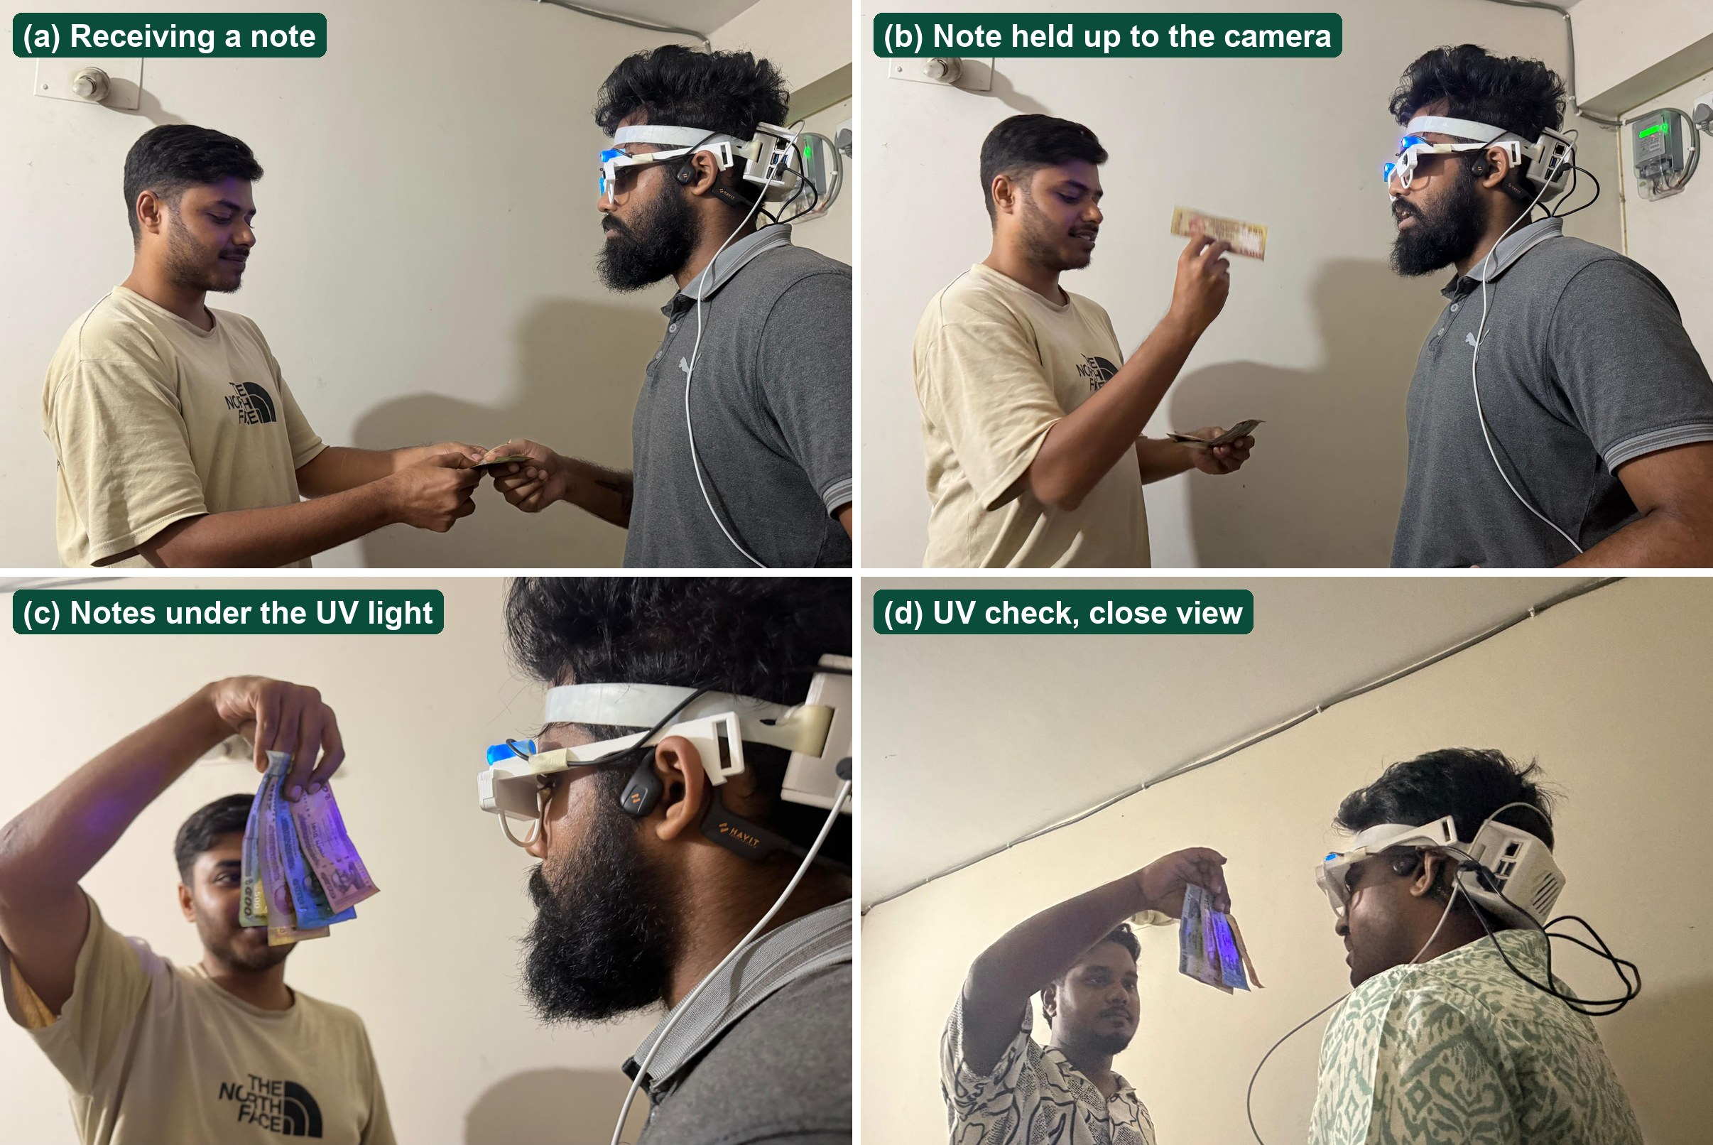
Prototype Testing and Project Status
DONE
Engineering checks
Each part tested on held-out data, on a laptop and the Pi 5
PRELIMINARY
First field test
Glass camera: currency unreliable, Bangla text not read
IN PROGRESS
Participant trials
Sessions with a visually impaired participant have started
NONE YET
Full user study
No results about users are claimed
Prototype version 2 in a staged shop exchange by team members; illustration only, no error rate counted.
Notes:
The second prototype on team members. The first field test with the glass camera was not good enough: currency was unreliable and Bangla text was not read, probably because of the low-resolution fixed-focus camera. Sessions with a visually impaired participant have started, with a Bangla voice questionnaire, but no user study is complete yet, so we make no claims about users.

Slide 23


Future Directions
1
2
3
4
Camera
User study
More banknotes
Speed and cooling
Higher resolution or autofocus
8–12 participants, including their own voice commands
Unseen counterfeit prints; UV check on real fakes
Time the new code on the Pi; better cooling; battery
Done: engineering tests In progress: participant trials Future: the four steps above
Notes:
Our roadmap has four steps. First, a better glass camera with higher resolution or autofocus, and a test set taken through the glass. Second, the user study with eight to twelve participants: task time, accuracy, SUS and NASA-TLX, including voice commands spoken by people and Bangla command words. Third, more banknotes: about a hundred unseen counterfeit prints with a bank or the police, and the UV check on real counterfeits. Fourth, speed and cooling: timing the new code on the Pi, better cooling and battery life.

Slide 24

Conclusion
Built
An offline Raspberry Pi 5 glass that reads Bangla and English, names objects and Taka notes, and speaks Bangla
Investigated
Synthetic training data, prefix training, unseen prints, a safe verdict, DMWR, hand-held notes, OCR, voice
Still to validate
Real counterfeits (also under UV), people's voices, the glass camera, a completed user study
Notes:
To sum up: SARA turns three everyday moments, money, reading and the street, into questions the user can ask the glass. It is an assistive glass that speaks Bangla and runs on a Raspberry Pi 5, tested part by part on held-out data, with new methods for counterfeit checking and hand-held notes. Still to be validated: real counterfeit notes, including under the UV lamp; voice commands spoken by people; the glass camera; and a completed user study.

Slide 25
THANK YOU
Questions?
SARA · Smart Assistive Reading Aid · Independent University, Bangladesh
Notes:
Thank you; we are happy to take questions.

Slide 26
References
[1] World Health Organization. Blindness and vision impairment: fact sheet, updated 10 February 2026.
[2] OrCam Technologies. OrCam MyEye.
[3] Ali A., H. et al. A Google Glass based real-time scene analysis for the visually impaired. IEEE Access 9, 2021.
[4] Brilli, D. D. et al. AIris: an AI-powered wearable assistive device for the visually impaired. arXiv:2405.07606, 2024.
[5] Adusumilli, V. et al. Reading aid and translator with Raspberry Pi for blind people. ICACCS, 2023, pp. 327-331.
[6] Uddin, M. S., Das, P. P., Roney, M. S. A. Image-based approach for the detection of counterfeit banknotes of Bangladesh. ICIEV, 2016.
[7] Pathak, A. et al. Enhanced counterfeit detection of Bangladesh currency through convolutional neural networks. IJIRCST 12(2), 2024.
[8] Chowdhury, A. A. et al. Evaluation of deep learning models on UV ink: a fake money detection scheme with RPN. ICCA (ACM), 2022.
[9] Piyas, B. R. C. et al. JaalTaka: a benchmark dataset for detecting counterfeit Bangladeshi banknotes. Mendeley Data V2, 2025.
[10] Piyas, B. R. C. et al. JaalTaka: a benchmark dataset for detecting counterfeit Bangladeshi banknotes. Data in Brief 64, 112377, 2026.
[11] Alpha Cephei. Vosk offline speech recognition toolkit.
[12] Raspberry Pi Ltd. Raspberry Pi 5 product brief, 2023.
[13] Jocher, G., Qiu, J., Chaurasia, A. Ultralytics YOLO, version 8.0.0, 2023.
[14] Baek, Y. et al. Character region awareness for text detection (CRAFT). CVPR, 2019.
[15] JaidedAI. EasyOCR: ready-to-use OCR with 80+ languages.
[16] Lin, T.-Y. et al. Microsoft COCO: common objects in context. ECCV, 2014.
[17] Rhasspy. Piper: a fast, local neural text-to-speech system.
[18] Li, S., Deng, W., Du, J. Reliable crowdsourcing and deep locality-preserving learning for expression recognition in the wild (RAF-DB). CVPR, 2017.
[19] eSpeak NG text-to-speech.
[20] Nuhash, M. N. I., Akter, S., Mojumdar, M. U. A diverse image dataset for Bangladeshi currency recognition (BanglaTaka). Mendeley Data V1, 2024.
[21] Rafi, M. J. A., Rony, M., Majadi, N. NSTU-BDTAKA: an open dataset for Bangladeshi paper currency detection and recognition. Data in Brief 55, 2024.
[22] Sandler, M. et al. MobileNetV2: inverted residuals and linear bottlenecks. CVPR, 2018.
[23] Mutanen, J., Jaaskelainen, T., Parkkinen, J. P. S. Luminescent security properties of banknotes. IS&T PICS Conference, 2003, pp. 421-424.
[24] Nayef, N. et al. ICDAR2019 robust reading challenge on multi-lingual scene text (RRC-MLT-2019). ICDAR, 2019.
[25] Piczak, K. J. ESC: dataset for environmental sound classification. ACM Multimedia, 2015.
Notes:
The sources cited on the slides, numbered as in the slides.

Slide 27



Resources and Links
Our code and results
Datasets
Open-source tools
SARA: glass software for the Raspberry Pi 5
github.com/aflam330/SARA
Research repository: experiments, results, thesis
github.com/aflam330/Senior_project_wearable_glass_for_blind_people_using_ocr_and_ylo
JaalTaka (counterfeit notes)
data.mendeley.com/datasets/2m7wk5cy4c/2
BanglaTaka (note photos)
data.mendeley.com/datasets/3cv2sypkkh/1
NSTU-BDTAKA (hand-held notes)
www.sciencedirect.com/science/article/pii/S2352340924006681
Microsoft COCO
cocodataset.org
ICDAR 2019 MLT
rrc.cvc.uab.es/?ch=15
ESC-50 environmental sounds
github.com/karolpiczak/ESC-50
Ultralytics YOLOv8
github.com/ultralytics/ultralytics
EasyOCR
github.com/JaidedAI/EasyOCR
Piper text-to-speech
github.com/rhasspy/piper
Vosk speech recognition
alphacephei.com/vosk/
eSpeak NG
github.com/espeak-ng/espeak-ng
WHO vision fact sheet
www.who.int/news-room/fact-sheets/detail/blindness-and-visual-impairment
Notes:
Our code is public on GitHub: the glass software and the research repository with every experiment. The datasets and open-source tools we used are linked here.

